Slide 1

Huazhong University of Science and Technology
The Department of Electronics and Information Engineering
Electronic Circuit Analysis and Design
Dr. Tianping Deng
Email: dengtp@hust.edu.cn

Slide 2
Contents
PART 1 SEMICONDUCTOR DEVICES AND BASIC APPLICATIONS
Chapter 1 Semiconductor Materials and Diodes
Chapter 2 Diode Circuits
Chapter 3 The Field-Effect Transistor
Chapter 4 Basic FET Amplifiers
Chapter 5 The Bipolar Junction Transistor
Chapter 6 Basic BJT Amplifiers
Chapter 7 Frequency Response
Chapter 8 Output Stages and Power Amplifiers
PART 2 ANALOG ELECTRONICS
Chapter 9 Ideal Operational Amplifiers and Op-Amp Circuits
Chapter 10 Integrated Circuit Biasing and Active Loads
Chapter 11 Differential and Multistage Amplifiers
Chapter 12 Feedback and Stability
Chapter 13 Operational Amplifier Circuits
Chapter 14 Nonideal Effects in Operational Amplifier Circuits
Chapter 15 Applications and Design of Integrated Circuits
Chapter 13 Operational Amplifier Circuits

Slide 3

13.0 Preview
13.1 General Op-Amp Circuit Design
13.2 A Bipolar Operational Amplifier Circuit
13.3 CMOS Operational Amplifier Circuits
13.4 BiCMOS Operational Amplifier Circuit
13.5 JFET Operational Amplifier Circuits
13.6 Summary

Slide 4
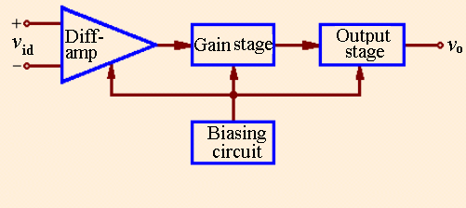
Ch13 Integrated Operational Amplifier
13.1 General Operational Amplifier Circuit Design
1. General Block Diagram of Op-Amp Circuit
General block diagram of Op-Amp Circuit

Slide 5
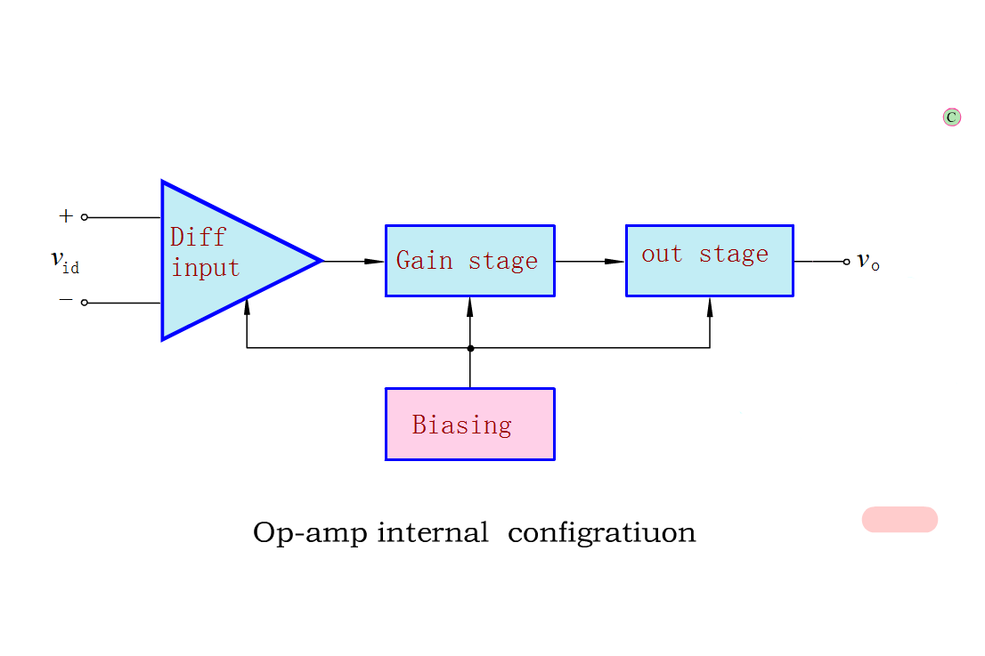
General block diagram of Op-Amp Circuit

Slide 6
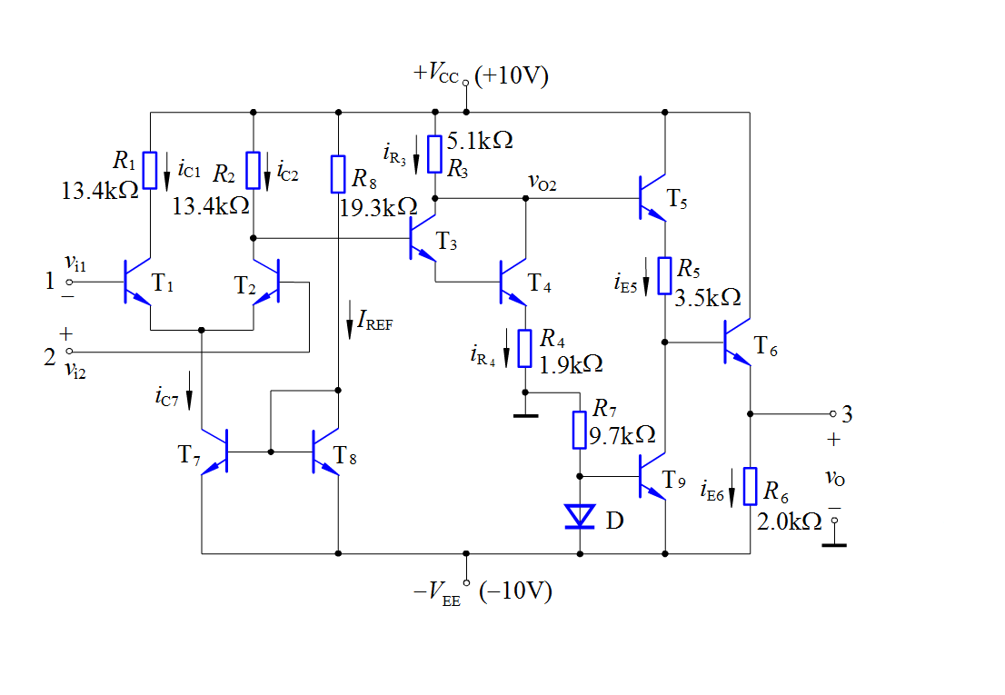
A simple op-amp

Slide 7
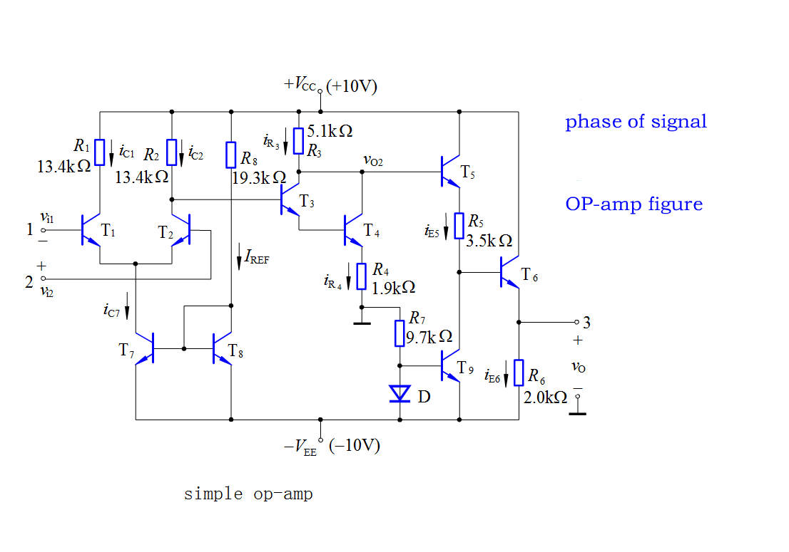
A simple op-amp

Slide 8
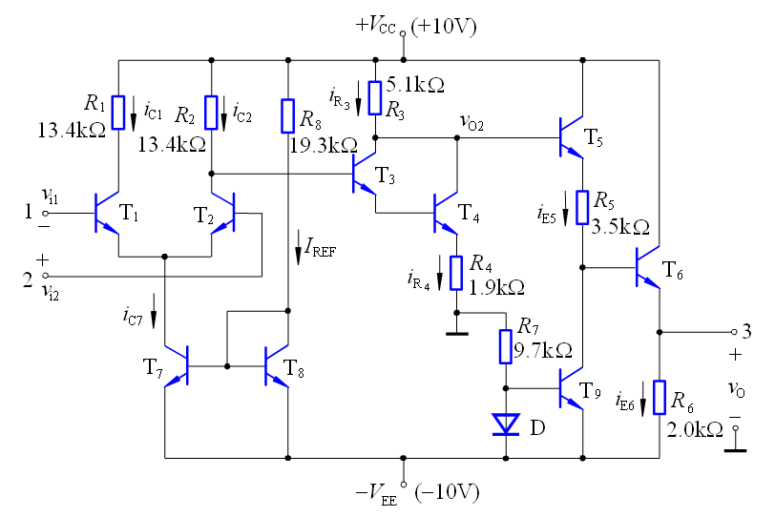







A simple op-amp — DC analysis

Slide 9
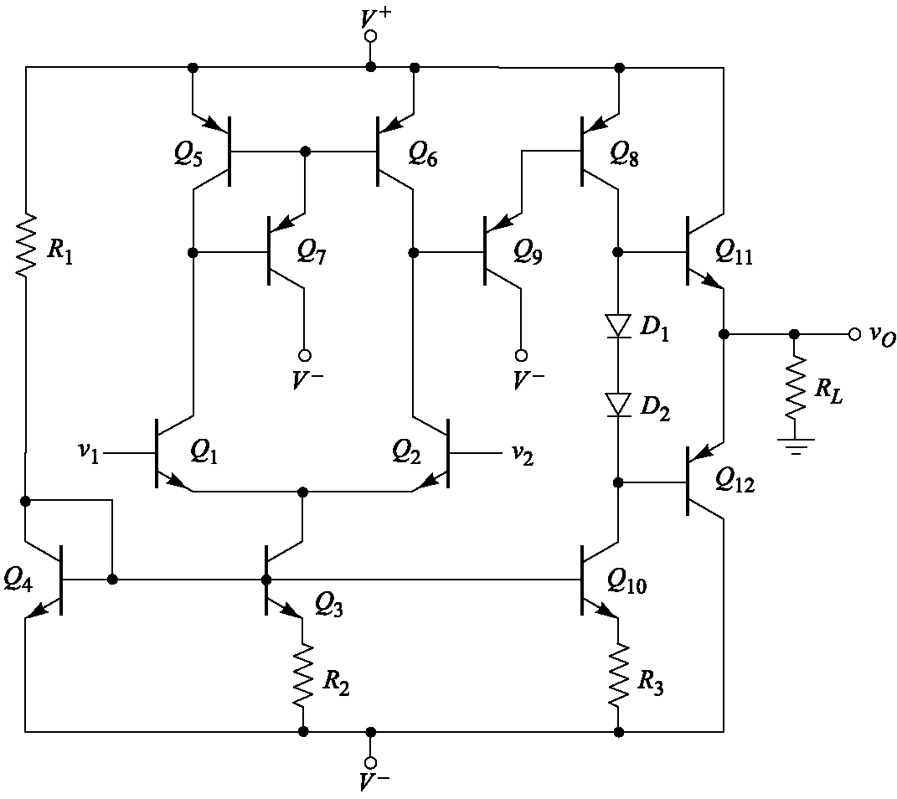
13.1 Operational Amplifier Circuit
2. General Configuration of Op-Amp Circuit
A simple bipolar operational amplifier

Slide 10
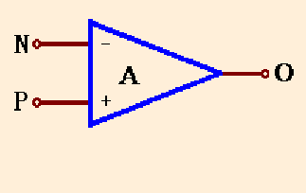
13.1 Operational Amplifier Circuit
3. The Phases and Symbol
Op-amp has two input terminals _inverting input terminal and noninverting input terminal and one output terminal. It also requires dc power.
Symbol
Op-Amp Characteristics:
Voltage gain is very large.
Input resistance is very large.
Output resistance is very small.

Slide 11
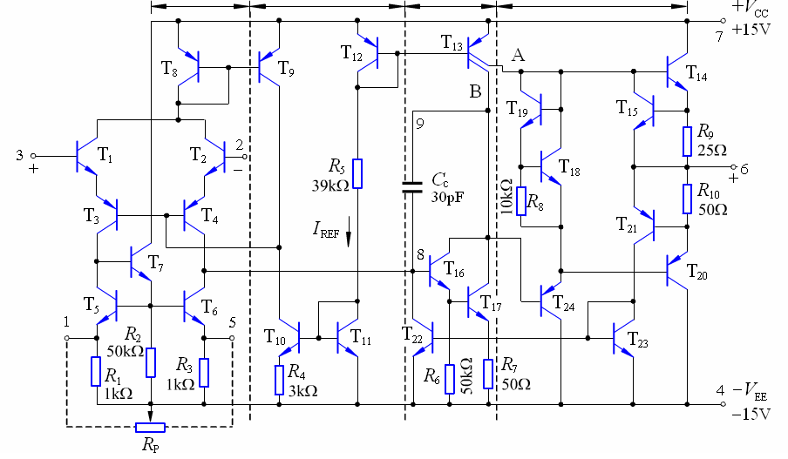
13.2 Circuit Description of 741 Op-Amp
Equivalent Circuit

Slide 12
General Description
24 transistors, few resistors and only one capacitor
Two power supplies
Short-circuit protection

Slide 13
How many current source in the figure？

Slide 14
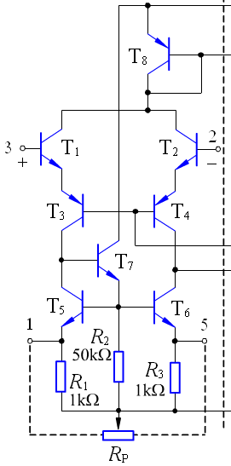
The Input Stage
※ The input stage consists of
transistors Q1 through Q7.
※ Q1-Q4 is the differential version
of CC and CB configuration.
※ High input resistance.
※ Current source (Q5-Q7) is the active
load of input stage. It not only
provides a high-resistance load but
also converts the signal from
differential to single-ended form
with no loss in gain or common-
mode rejection.

Slide 15
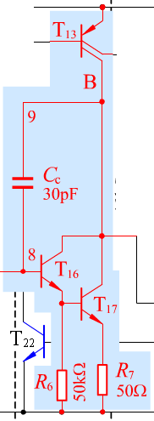
The Intermediate Stage
※ The intermediate stage is composed
of Q16, Q17 and Q13B.
※ Common-collector configuration for Q16
gives this stage a high input resistance as
well as reduces the load effect on the
input stage.
※ Common-emitter configuration for Q17
provides high voltage gain because of the
active load Q13B.
※ Capacitor Cc introduces the miller
compensation to insure that the op amp has
a very high unit-gain frequency.

Slide 16
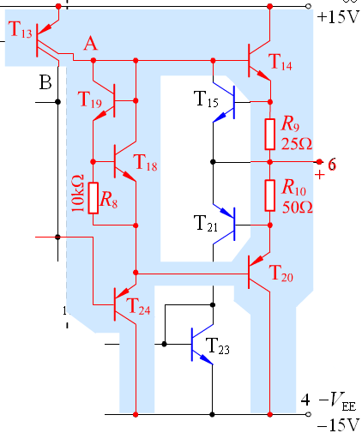
The Output Stage
※ The output stage is the efficient circuit
called class AB output stage.
※ Voltage source composed of Q18 and Q19
supplies the DC voltage for Q14 and Q20 in
order to reduce the cross-over distortion.
※ Q23 is the CC configuration to reduce the
load effect on intermediate stage.
※ Short-circuit protection circuitry
◇Forward protection is implemented by R6 and Q15.
◇ Reverse protection is implemented by R7, Q21,
current source(Q24, Q22) and intermediate stage.

Slide 17
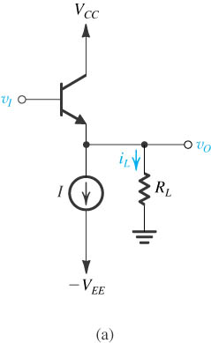
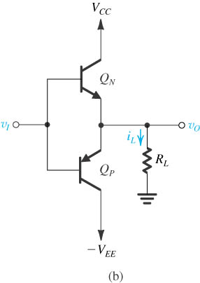
The Output Stage
(a) The emitter follower is a class A output stage. (b) Class B output stage.

Slide 18
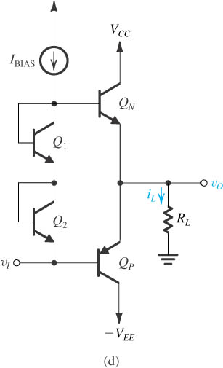
The Output Stage
Q_{N} and Q_{P} provides the voltage drop which equals to the summer of turn-on voltages of Q_{N} and Q_{P.}
This circuit is call Class AB output stage.

Slide 19
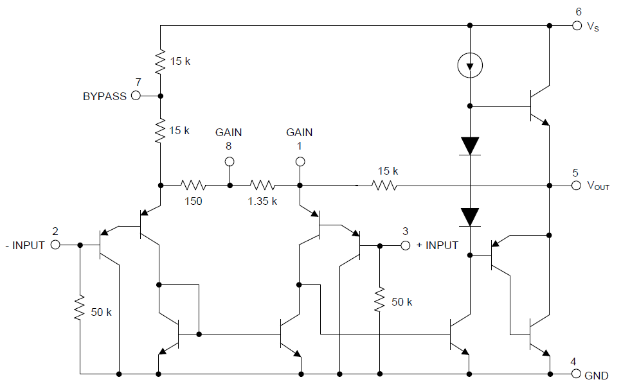
Example: explain the configuration of the circuit.
LM386 power amp

Slide 20
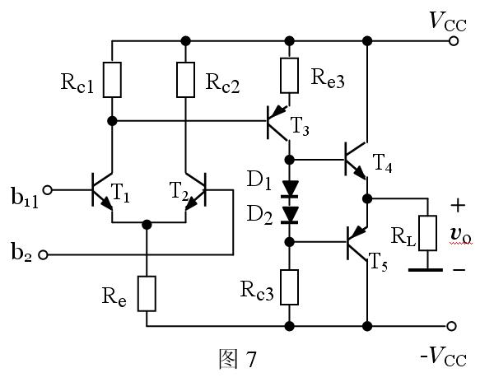

Example: explain the configuration of the circuit.

Slide 21
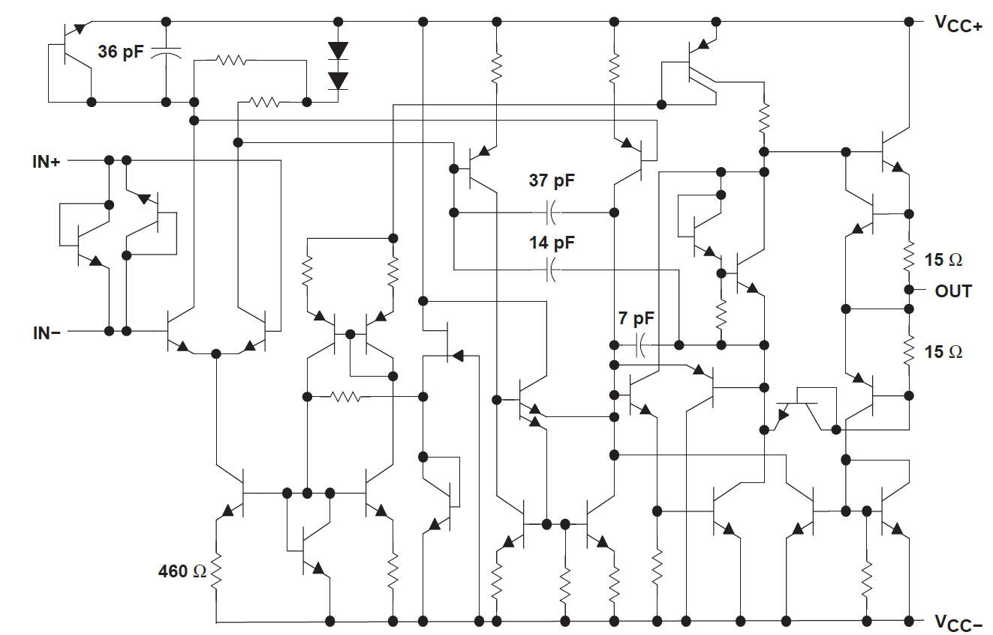


Slide 22
Questions
and
Answers

